Slide 1



CUSTOMER CHURN PREDICTION
for Telecommunications company
CAPSTONE PROJECT
PRESENTED BY:
Pak Hui Fen

Slide 2


01 | Problem Statement
02 | Business Impact
03 | Dataset Overview
04 | Data Cleaning & Preprocessing
05 | Exploratory Data Analysis (EDA)
06 | Model Building
07 | Feature Importance
08 | Deployment
09 | Business Recommendations
Agenda
Notes:
"Here's a quick look at what we'll cover today—from understanding what churn is and why it matters, to how I approached solving it using data science methods, and finally the impact of the solution."

Slide 3

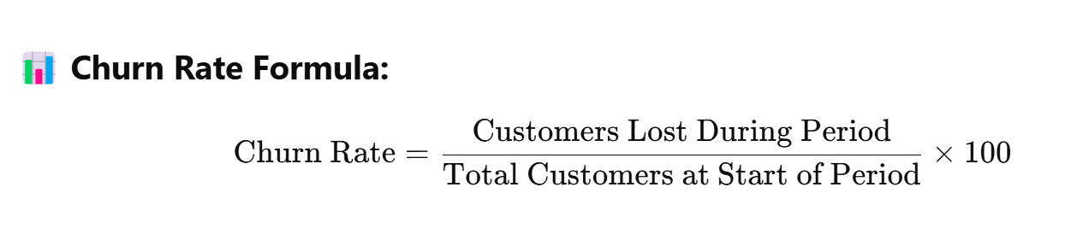
Introduction
What is churn?
Churn = Customer loss
It’s often measured as a percentage of customers lost during a specific time period.
🧠 Why Churn Matters:
It's more expensive to acquire a new customer than to keep an existing one.
High churn often signals poor customer experience, pricing issues, or lack of product fit.
Reducing churn = increased revenue, customer lifetime value, and brand loyalty.
Notes:
Let’s begin with a quick overview of what churn means.
Churn simply refers to customer loss — when a customer stops using a company’s service.
It’s usually expressed as a percentage, using the formula shown here:
The number of customers lost during a specific period divided by the total number of customers at the start — multiplied by 100.
So why does churn matter?
First, it’s much more expensive to acquire a new customer than to retain an existing one.
Forbes cites research indicating that boosting customer retention by just 5% can increase profit by 25% to 95%.
Second, a high churn rate can signal deeper problems like poor customer experience, pricing dissatisfaction, or lack of value.
And finally, reducing churn leads to tangible business benefits — like increased revenue, better customer lifetime value, and stronger brand loyalty.

Slide 4
Problem Statement
Business Objective
As a Business Analyst at a telecom company, I aim to identify key churn drivers and predict customers at risk of leaving in the next billing cycle—enabling proactive retention strategies that protect revenue and maximize customer lifetime value.
Project Objective
The objective of this project is to:
🔍 Analyze customer data to uncover patterns and trends related to churn
📈 Identify key drivers that influence the likelihood of customer churn
🤖 Build and evaluate a predictive model to identify customers at high risk of churning
🧩 Provide strategic insights and recommendations to support proactive customer retention efforts
Notes:
“This project focuses on helping the business proactively reduce customer churn.
Stakeholders
This project benefits stakeholders including:
Customer Retention and Success Teams: Seeking proactive engagement solutions for at-risk customers.
Marketing Managers: Aiming to enhance campaign effectiveness and reduce churn.
CRM Administrators: Integrating predictive analytics into customer management systems.
Data Analysts and Scientists: Deriving actionable insights from data.
Senior Management and Executives: Making strategic decisions focused on revenue protection and profitability.
Product Managers: Refining customer experience and service offerings.
The business objective is to identify customers likely to leave in the next billing cycle and understand the reasons why—so we can take early action to retain them, protect revenue, and maximize customer lifetime value.
The project objective is to:
Analyze customer data to uncover churn patterns
Identify key drivers behind churn behavior
Build a predictive model to detect high-risk customers
And provide actionable insights to support targeted retention strategies
In short, this project bridges data with strategy to drive better customer outcomes.”

Slide 5
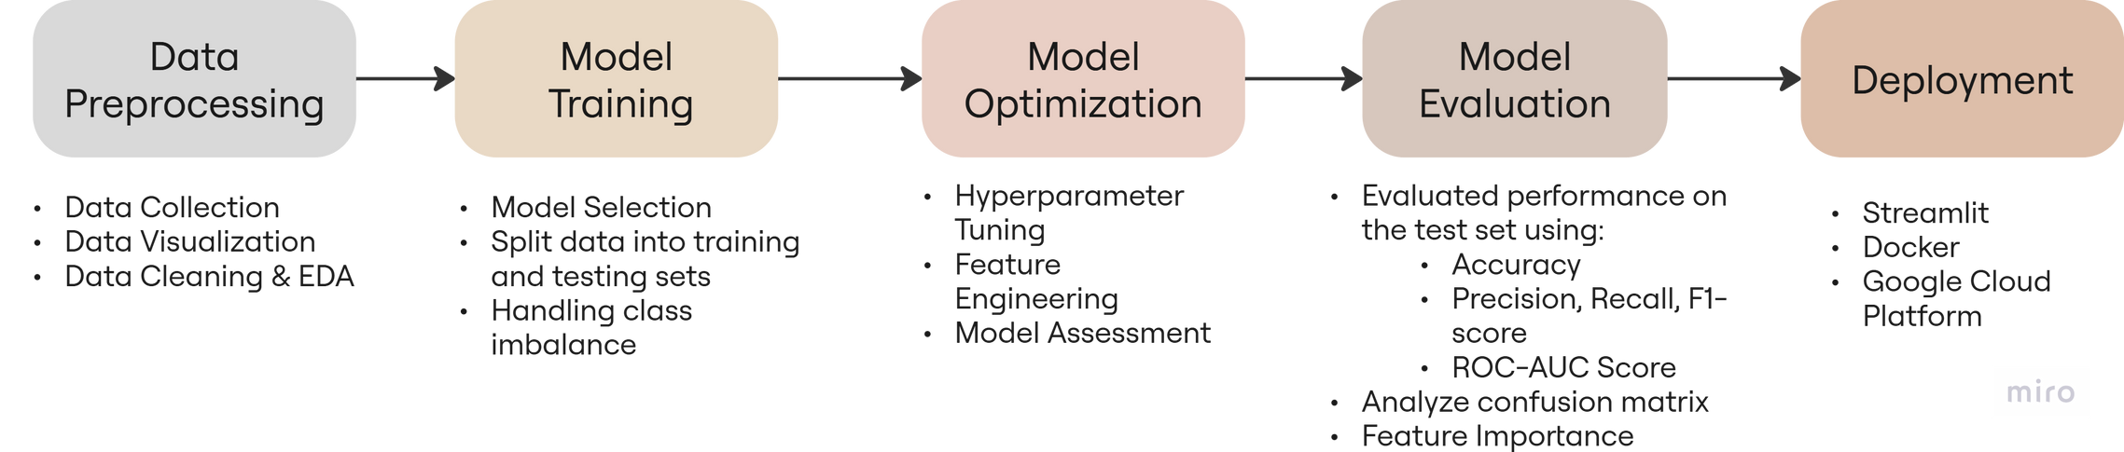
Data Science Process
Transforming Beyond Dataset
Notes:
This is the high-level data science workflow I followed—starting from understanding the problem, moving through data preparation, model building, evaluation, and ending with deployment.

Slide 6

Dataset: Telco Customer Churn
Source: IBM via Kaggle
Total of 7,043 entries in the dataset.
Target Variable : Churn Label (Yes/No)
Dataset Overview
Feature Category | Example Columns | Dropped
Customer Info | CustomerID, Gender, Senior Citizen, Partner, Dependents | CustomerID
Service Details | Phone Service, Internet Service, Tech Support, Streaming TV
Account Details | Tenure Months, Contract, Payment Method, Paperless Billing
Billing | Monthly Charges, Total Charges, CLTV | CLTV
Churn Indicators | Churn Label | Churn Value, Churn Reason, Churn Score
Notes:
The dataset comes from IBM via Kaggle and contains 7,043 customer records. The target variable is binary—whether a customer churned or not.

Slide 7
Data Preprocessing
Converted “Total Charges” numeric data type
Handled 11 missing values in “Total Charges”
Dropped “Churn Reason” due to 5,174 missing values
Removed unused columns like geographic info and IDs
Label encoded categorial columns such as Gender, Internet Service
Scaled numerical features using StandardScaler
Created new features :
Average Spend Per Month
Additional Services Count
Notes:
To prepare the data for modeling, I cleaned and transformed several key elements.
I started by converting ‘Total Charges’ to numeric and handled 11 missing values. The ‘Churn Reason’ column was dropped due to too many missing entries.
I also removed non-essential fields like IDs and geographic details.
Categorical columns such as Gender and Internet Service were label encoded, and I applied StandardScaler to normalize numerical features.
Lastly, I created two new features:
Average Spend Per Month, to reflect spending behavior
Additional Services Count, to show engagement with extra services
These steps helped ensure the data was clean, balanced, and model-ready.

Slide 8
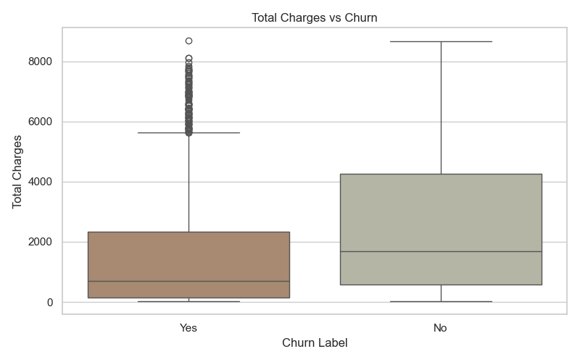
Data Visualization
Visualization of customer behaviour and churn patterns have guided understanding of churn drivers.
Notes:
The visualizations revealed clear churn patterns—customers with short tenure, month-to-month contracts, or who paid via electronic check were more likely to churn.
We also saw that churned customers tend to have lower total charges, indicating they left early. This shows that churn is more common among newer users, highlighting the importance of a strong onboarding experience and early support to drive retention.

Slide 9
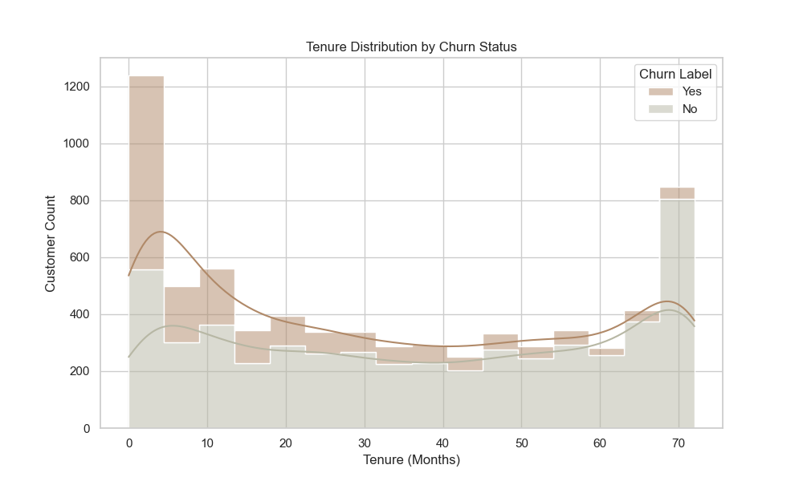
Data Visualization
Visualization of customer behaviour and churn patterns have guided understanding of churn drivers.
Notes:
The Tenure Distribution shows churn is highest among customers with short tenures. Many leave in the first few months, while those who stay beyond 40 months are far less likely to churn.
This highlights the need to focus on early-stage retention through smooth onboarding and strong initial support.

Slide 10
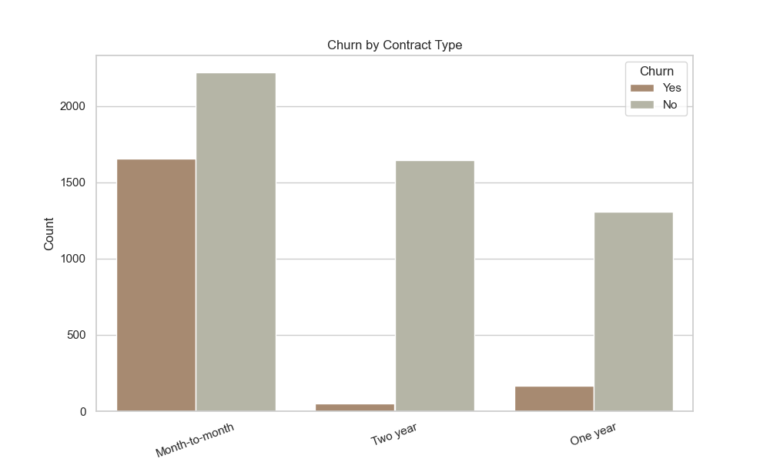
Data Visualization
Visualization of customer behaviour and churn patterns have guided understanding of churn drivers.
Notes:
Customers on month-to-month contracts churn the most, while those on one- or two-year contracts are more likely to stay.
This suggests that longer-term contracts encourage retention. Offering incentives to lock in longer commitments can help reduce churn.

Slide 11
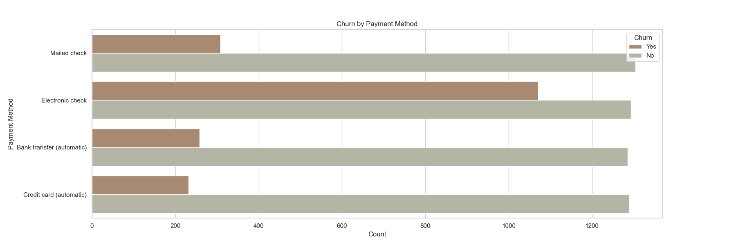
Data Visualization
Visualization of customer behaviour and churn patterns have guided understanding of churn drivers.
Notes:
Customers using electronic checks have the highest churn, while those on auto-pay methods like bank transfers or credit cards are more likely to stay.
This suggests that auto-pay users are more committed, and promoting these options could help reduce churn

Slide 12
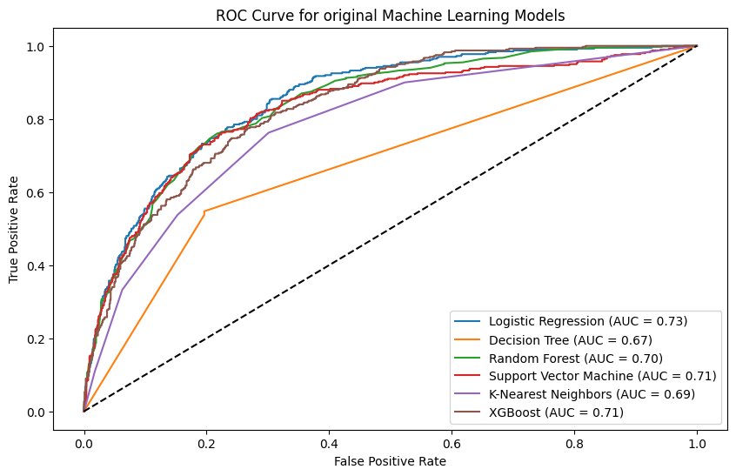
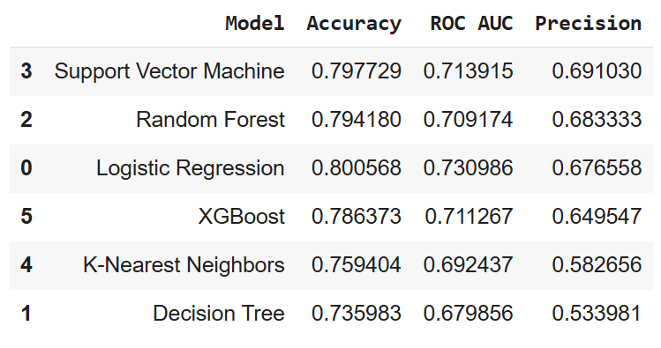
Model Building
Multiple models such as Logistic Regression, Decision Tree, Random Forest, and etc
were tested to predict churn.
Chose Random Forest as best baseline
Handled Class Imbalance since only 26% of the customers churned
Adopted Upsampling due to better performance with higher AUC (0.9784 vs 0.8399)
Notes:
I tested Logistic Regression, Decision Tree, and Random Forest. Random Forest performed best due to its ability to handle complex data.
To address class imbalance, I applied upsampling, which significantly improved the model's ability to detect churn.
I also performed hyperparameter tuning, but it didn’t yield a significant performance boost—indicating the default Random Forest was already near-optimal.
In the end, I selected the upsampled Random Forest model for its strong overall performance and reliability.

Slide 13
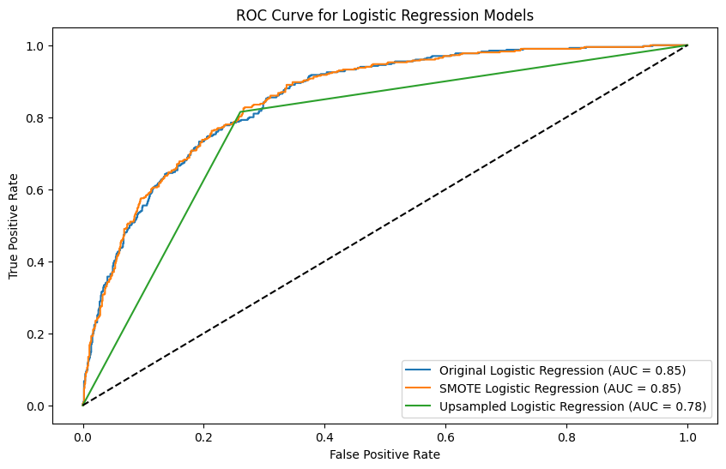
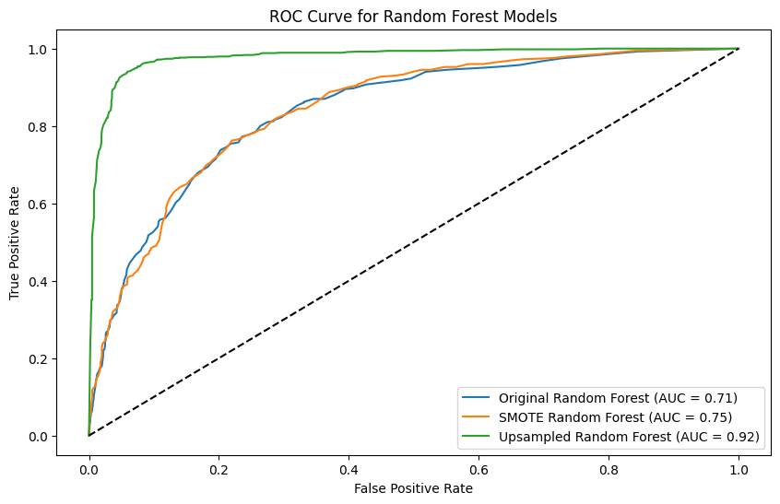
Model Evaluation
Original Logistic Regression (LR) base model : 0.85
SMOTE LR model : 0.85
Upsampled LR model : 0.78
Original Random Forest base model : 0.71
SMOTE + Random Forest base model : 0.75
Upsampled Random Forest base model: 0.92
Notes:
Here, we compare Logistic Regression and Random Forest models using AUC scores and ROC curves.
For Logistic Regression, both the original and SMOTE versions achieved an AUC of 0.85, while the upsampled version performed slightly worse at 0.78.
Random Forest started lower with an AUC of 0.71, but improved with SMOTE to 0.75. The biggest gain came from upsampling, pushing AUC to 0.92—the best overall performance.
This shows how addressing class imbalance significantly boosted the model’s ability to correctly identify churned customers.
-----
Concern for choosing Upsampled Random Forest model due to overfitting risk :
Yes, overfitting is something I was mindful of since upsampling and Random Forests can sometimes memorize the training data. To mitigate that, I evaluated all models using a separate test set and tuned hyperparameters using randomized search with cross-validation. I compared metrics like recall and AUC — which showed that my hypertuned upsampled model performs well on unseen data. I also looked at the ROC curve and confusion matrix to make sure the model wasn’t overly biased. If needed, I could also apply k-fold CV or try simpler models for comparison.

Slide 14
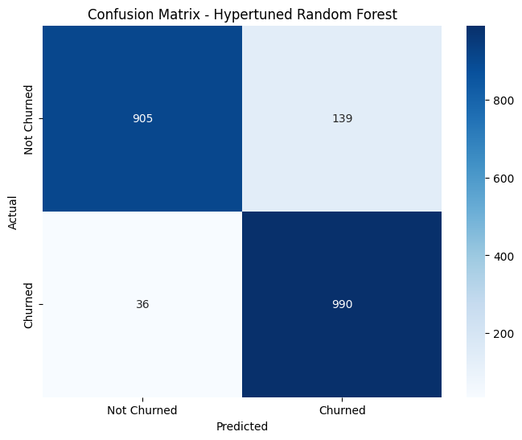
Confusion Matrix
The hypertuned Random Forest model achieved high accuracy and an excellent recall rate, meaning it’s highly effective at identifying customers likely to churn—allowing us to intervene before it’s too late.
✅ Key Takeaways
High True Positives (990): Great performance in detecting churners.
Very Low False Negatives (36): Our model rarely misses actual churn cases, which is crucial for customer retention.
Balanced Accuracy: Although we do have some false positives (139), it’s often safer to err on the side of caution in churn prediction.
Notes:
The model correctly predicted 990 churn cases and only missed 36—an excellent result. This high recall is essential because it means we’re catching most of the customers at risk."
-----
✅ Key Takeaways
High True Positives (990): Great performance in detecting churners.
Very Low False Negatives (36): Our model rarely misses actual churn cases, which is crucial for customer retention.
Balanced Accuracy: Although we do have some false positives (139), it’s often safer to err on the side of caution in churn prediction.
----
1. True Negatives (905)
“These are 905 customers who did not churn, and the model correctly predicted them as not churned.”
2. True Positives (990)
“These are 990 customers who did churn, and the model correctly predicted them as churned. This is the most critical group—we caught almost all churners.”
3. False Positives (139)
“These are customers the model wrongly predicted would churn, but they didn’t. This may lead to unnecessary retention offers but is not a severe issue.”
4. False Negatives (36)
“These 36 are customers the model missed—they churned, but the model predicted they wouldn’t. This is what we want to minimize, and our model performs very well here.”

Slide 15
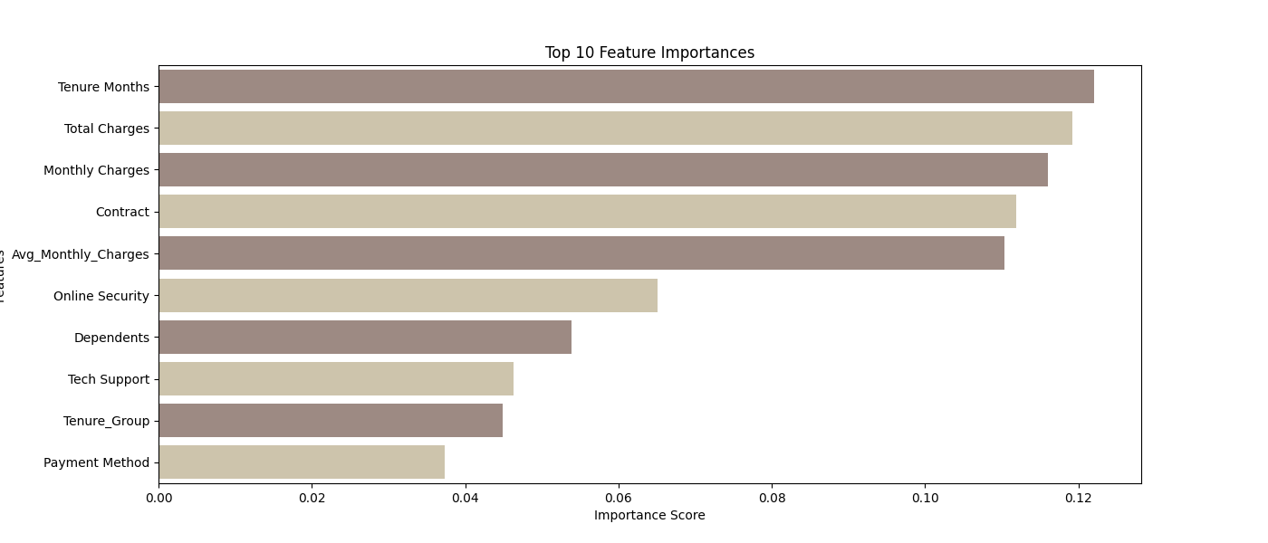
Feature Importance
Tenure Months is the top predictor
Total & Monthly Charges strongly influence churn
Month-to-month contracts are linked to higher risk
Choice of Online Security & Tech Support affects loyalty
Payment Method & Dependents also contributed to churn risk
Notes:
The Random Forest model shows that tenure and billing-related features are the strongest churn predictors.
Customers with shorter tenures, lower total charges, and those on month-to-month contracts are more likely to churn.
Other important factors include lack of online security, no dependents, or paying via electronic check.
These insights help to influence stakeholders decision making to target high-risk customers and design more effective retention strategies.

Slide 16
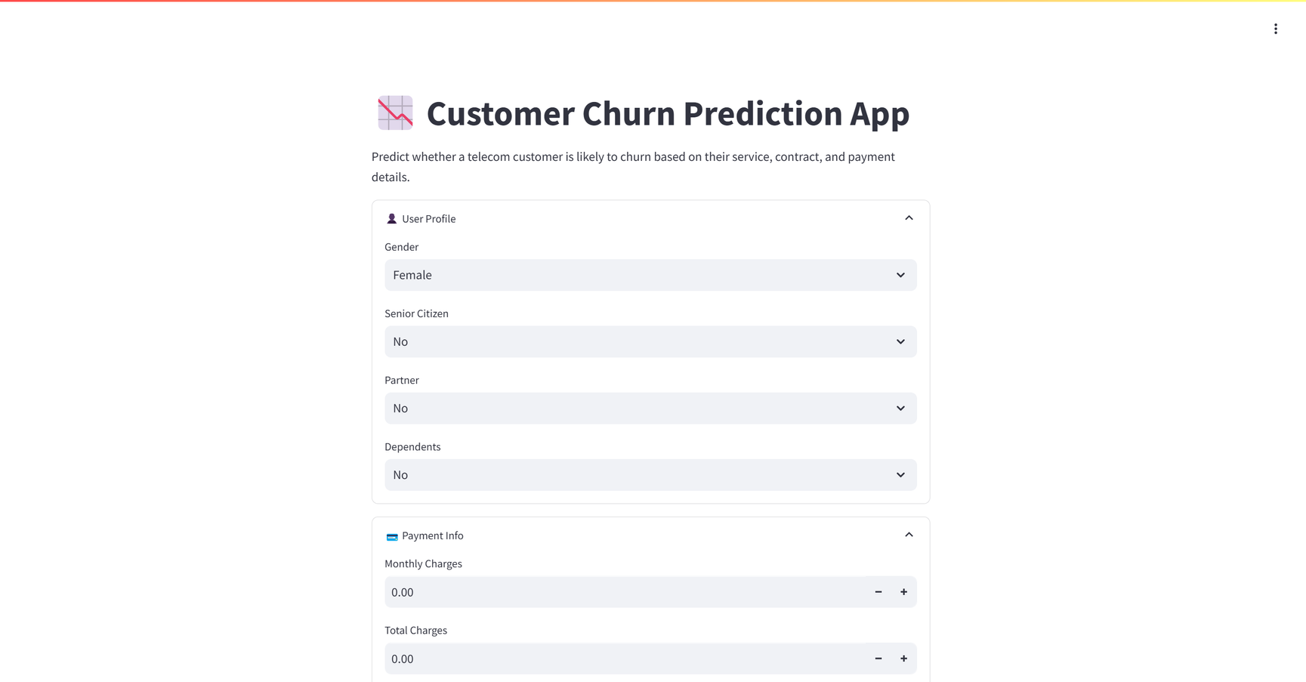
Deployment
The app have been deployed to Google Cloud using Docker & Cloud Run
Pushed to GCP Artifact Registry
Deployed to Cloud Run (live web app)
Allow real-time prediction via form input
Notes:
I deployed the model using Docker and Google Cloud Run. The web app allows internal users to input customer attributes and get real-time churn predictions."
https://churn-predictor-939566192323.asia-southeast1.run.app/

Slide 17
Conclusion / Future Work
Conclusion:
Prioritize retention efforts for:
New users (<12 months tenure)
Month-to-month contract holders
High monthly charge customers
Customers using Electronic Check
Offer incentives:
Loyalty rewards for early-tenure users
Bundled discounts for high-churn segments (e.g., Fiber Optic users)
Enable proactive outreach by integrating the deployed churn model with CRM tools
Continuously retrain the model with new data to maintain accuracy
Future Opportunities :
Deploy the model as a REST API for real-time predictions
Automate CRM alerts for high-risk customers
Enhance features with engagement metrics or complaint history
Experiment with advanced models (e.g., XGBoost, SHAP explainability)
Notes:
Retention efforts should target new users, high spenders, and those on month-to-month plans. I suggest loyalty incentives and bundled discounts. In future versions, we can enrich the model with CRM data or use interpretable methods like SHAP.

Slide 18
End of Presentation
Thank you

